Slide 1
Linux/bash commands, Text editors, HPC and schedulers, Molecule visualizers Python
Instructor: Prof. Tzuhsiung (Nick) Yang
Email: tyang@mx.nthu.edu.tw
Time: M5/6
Room: Chemistry Building R326
Notes:
Rafael Gomez

Slide 2
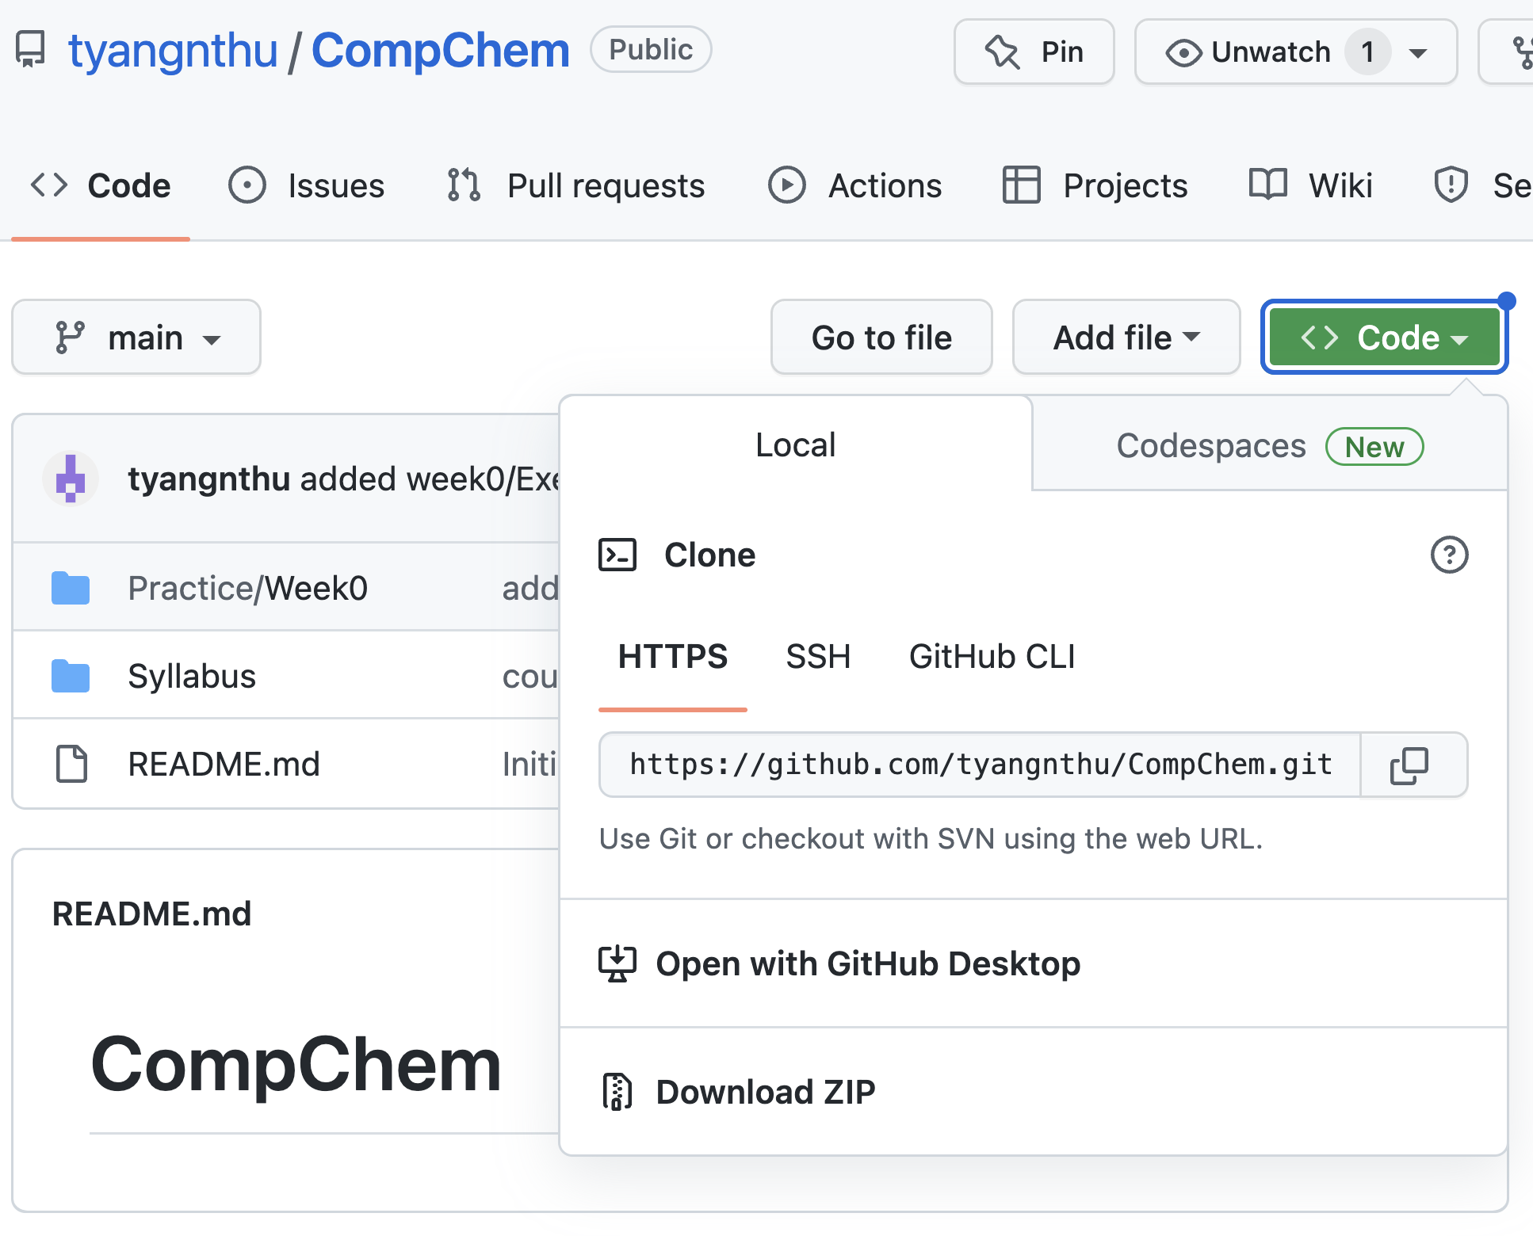
First
iService account registration (https://iservice.nchc.org.tw/nchc_service/index.php?lang_type=)
Start your browser
Go to https://github.com/tyangnthu/CompChem
Download course materials

Slide 3

Linux
The Unix operating system (OS) was created in 1969 at AT&T’s Bell Labs written in assembly language by Ken Thompson, Dennis Ritchie, and others.
Unix was rewritten in C language in 1971 and sold as a proprietary product in 1984 by Bell Labs.
The GNU Project was started in 1983 by Richard Stallman to build a Unix-compatible free software system.
Linux was developed by Linus Torvalds in 1991 as a computer science student at the University of Helsinki, Finland。
Due to it being GNU licensed, meaning that it is free to purchase and redistribute, there are many variants such as Ubuntu, Kali Linux, Fedora, Debian.

Slide 4
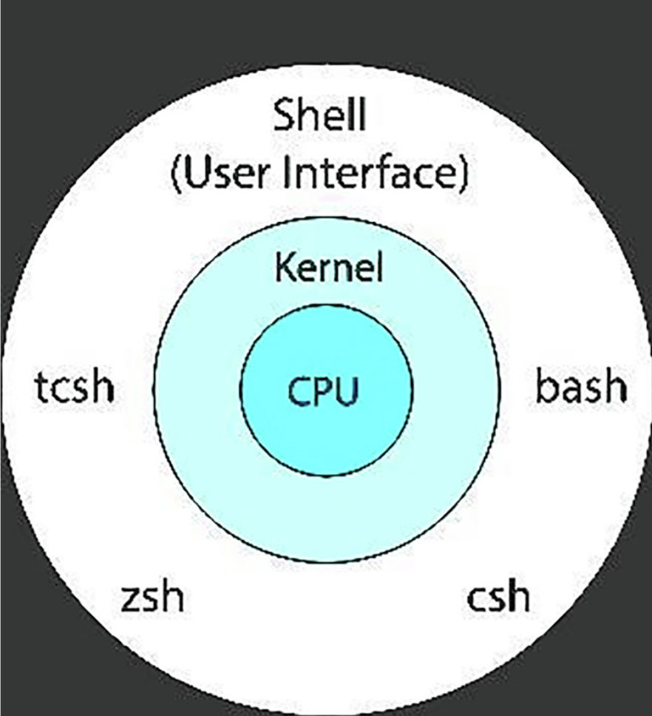
Shell
Shell is an interface between the OS (like Linux) and the user.
Whenever a user logs in or opens a terminal a new shell is launched by the OS.
There are two types of shells: 1) Command-Line Shell and 2) Graphical Shell.
There are many types of shell: C Shell, Bourne (sh) Shell, Korn Shell, GNU Bourne-Again (bash) Shell, The Z shell, and Fish shell.
A. Kidwai, C. Arya, P. Singh, M. Diwakar, S. Singh, K. Sharma, N. Kumar, Materials Today: Proceedings 2021, 37, 2612–2616.

Slide 5
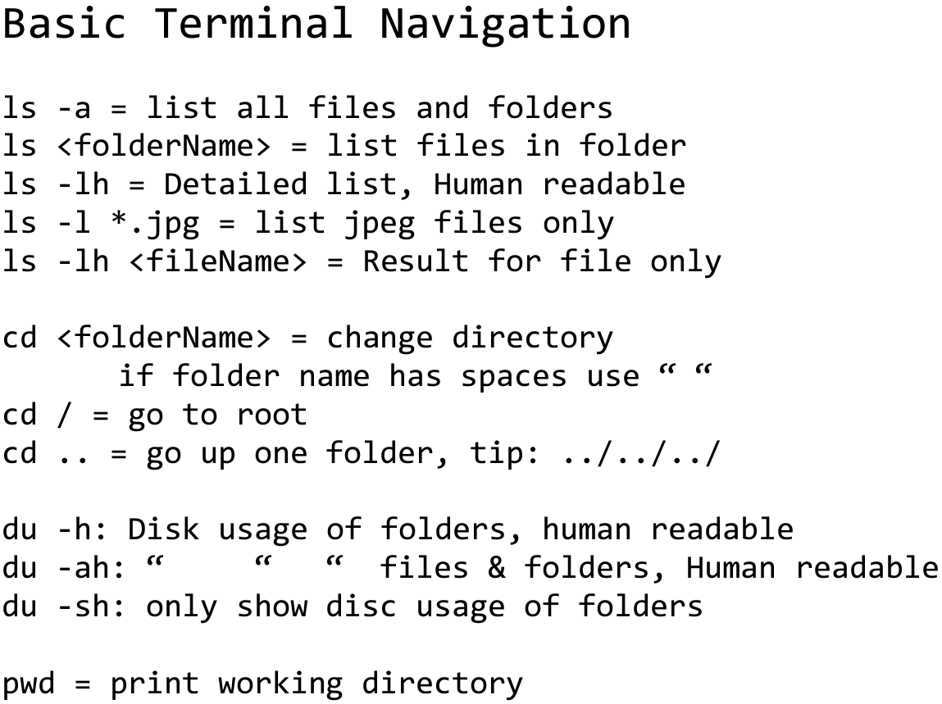
Common Bash commands

Slide 6
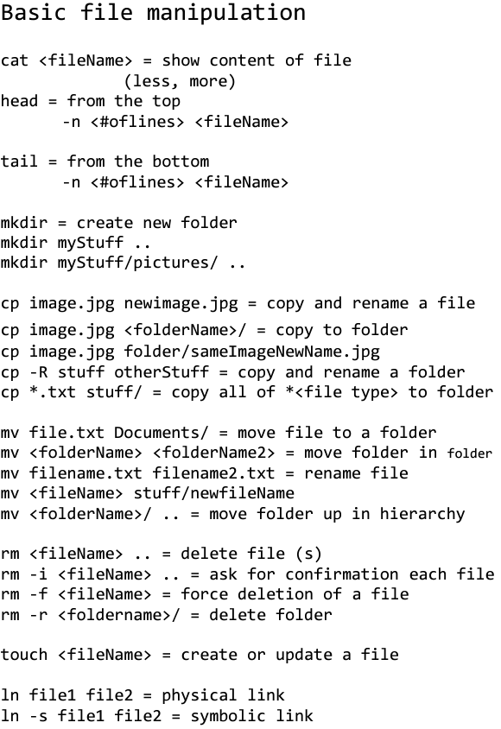
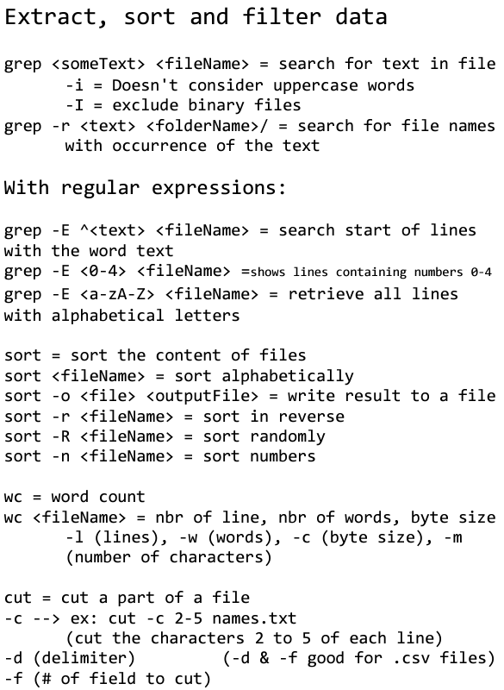
Common Bash commands

Slide 7
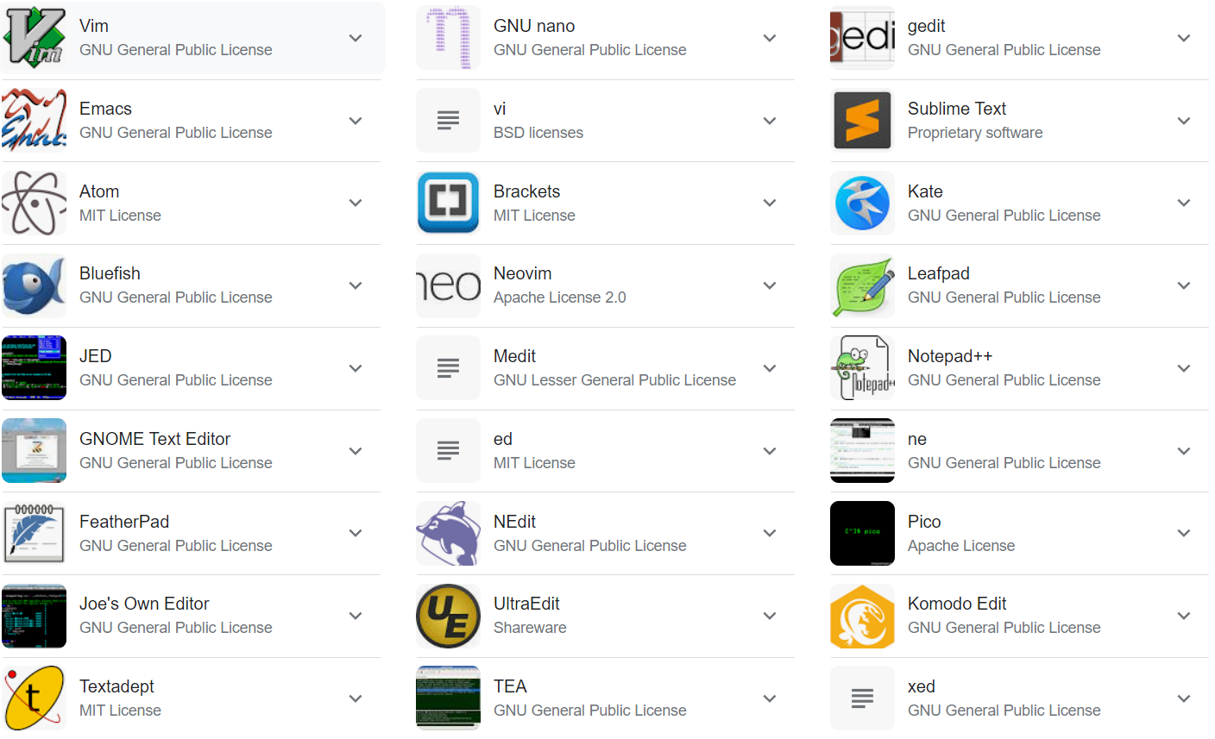
Text editors

Slide 8
Common vi commands
Cursor movement
0 - jump to the start of the line
^ - jump to the first non-blank character of the line
$ - jump to the end of the line
gg - go to the first line of the document
G - go to the last line of the document
5gg or 5G - go to line 5
Insert mode - inserting/appending text
i - insert before the cursor
I - insert at the beginning of the line
a - insert (append) after the cursor
A - insert (append) at the end of the line
o - append (open) a new line below the current line
O - append (open) a new line above the current line
Esc - exit insert mode
Exiting
:w - write (save) the file, but don't exit
:wq or :x or ZZ - write (save) and quit
:q - quit (fails if there are unsaved changes)
:q! or ZQ - quit and throw away unsaved changes
:wqa - write (save) and quit on all tabs
Search and replace
/pattern - search for pattern
?pattern - search backward for pattern
n - repeat search in same direction
N - repeat search in opposite direction
:%s/old/new/g - replace all old with new throughout file
:%s/old/new/gc - replace all old with new throughout file with confirmations

Slide 9

Files types
Items in red are archive files
Items in white are regular files
Items in blue are directories
Items in green are executable files

Slide 10
Interactive
cd ~/Downloads/CompChem/Practice/Week0/Exercise1
Unzip the zip file using
unzip files_to_clean_up.zip
Check the files using:
ls
Check the number of files using
ls | wc -l
Collect the files by moving the files with the same first two alphabets into the corresponding directory
mkdir AB
mv AB* AB/
repeat for AC/, AD/

Slide 11
Interactive
Automate the path change by using
for i in {A..Z}; do mkdir A${i}; mv A${i}*.xyz A${i}; done
Now move your path into one of the folders, AA/
cd AA
Check the number of lines in each file:
wc -l *
Change the name of the file AACANI10.xyz into aacani10.xyz:
mv AACANI10.xyz aacani10.xyz

Slide 12
Interactive
Check the content of aacan10.xyz using vi
vi aacani10.xyz
In the vim editor, move to the end of the file using
Shift+g
Append after the last line by
o
Type H 0.00 0.00 0.00

Slide 13
Interactive
Change the first number that specifies the number of atoms into 35 by
1 then Shift+g (specify the line number 1 then move over)
xx (delete the current character twice)
i then type 35 (change to the insert mode then type 35)
Esc (escape the insert mode)
Move to C by
/C (find the next Ni match)
n (move to the next match)

Slide 14
Interactive
Remove the current line of C (the second C):
dd (dd removes the current line)
Change all H into Cl
:%s/H/Cl/
Move to the first Cl by /Cl
Move to the end of the line by $ (Shift+4)
Append after the last character
a then space then type M = 37 (change the atomic mass of this Cl into 37)
Esc

Slide 15
Interactive
Move back to the beginning of the line by 0
Move to Ni by /Ni
Remove the following 8 lines by 8 then dd
Change the first line to reflect the new number of atoms
Save and quit by :q! then enter (q means quit, ! means in any condition)

Slide 16
Interactive
Now let’s repeat the process without going into any file
sed -i ‘$a H 0.00 0.00 0.00’ aacani10.xyz (-i means overwrite the original file; $ means the last line. It can also be the line number; a means append.)
natom=$(head -n 1 aacani10.xyz) (define the variable natom as one line from the beginning of the file, the first line. Command in $() is evaluated before passed to the variable)
sed -i “1s/${natom}/$((${natom}+1))/” aacani10.xyz (substitute the first of the file that matches the variable by the variable+1. Notice that we use “” instead of ‘’. In bash, special characters inside ‘’ are treated as strings; special characters inside “” are evaluated.)

Slide 17
Interactive
Another way to do 3. is
3’. sed -i ‘1s/.*//’ aacani10.xyz (substitute everything, .*, in the first line by an empty string)
then sed -i “1s/^/$((${natom}+1))” accani10.xyz (substitute the beginning, ^, of the first line with ${natom}+1)
Notice that bash guesses the data type of the variable. It considers 34 as an integer and allows you to directly add 1 to it by $((34+1)) without having to specify the data type. Bash is an interpretive language.

Slide 18
Interactive
Remove the line that contains the second C by first getting the line number of the second C by:
lnum=$(grep -n ‘^C ’ aacani10.xyz | sed ‘2!d’ | cut -d: -f1) (grep allows you to analyze the content of a file by any match; -n also returns the line number of the match; The match is ‘^C ‘, which specifies that the C character starts at the beginning of a line and has a space right after it; | means operating the output from the left side by the commands from the first; sed ‘2!d’ means delete everything except the second line; cut allows you to cut a string by the delimiter specified in the option -d and chooses the nth element by the option -f. Notice that bash starts counting at 1)

Slide 19
Interactive
sed -i “${lnum}d” aacani10.xyz removes the 4th line.
sed -i ‘s/C /Cl /’ aacani10.xyz
lnum=$(grep -n ‘^Cl ‘ aacani10.xyz | head -n 1 | cut -d: -f1) then sed -i “${lnum}s/$/ M = 37/” aacani10.xyz (substitute the end of the ${lnum}^{th} line by M = 37)
sed -i ‘/^Ni /,+7d’ aacani10.xyz (match /^Ni/ then delete the corresponding line and the next 7 lines)
sed -i “1s/.*/$(($(awk ‘END{print NR}’ aacani10.xyz)-2))/” aacani10.xyz ($(awk ‘END{print NR}’ aacani10.xyz) returns the number of lines in the file; NR prints the index of each line starting at 1; END means print the last line of the system output; $(()) is arithmetic)

Slide 20
Interactive
sed -i “${lnum}d” aacani10.xyz removes the 4th line.
sed -i ‘s/C /Cl /’ aacani10.xyz
lnum=$(grep -n ‘^Cl ‘ aacani10.xyz | head -n 1 | cut -d: -f1) then sed -I “${lnum}s/$/ M = 37/” aacani10.xyz (substitute the end of the ${lnum}^{th} line by M = 37)
sed -i ‘/^Ni /,+7d’ aacani10.xyz (match /^Ni/ then delete the corresponding line and the next 7 lines)
sed -i “1s/.*/$(($(awk ‘END{print NR}’ aacani10.xyz)-2))/” aacani10.xyz ($(awk ‘END{print NR}’ aacani10.xyz) returns the number of lines in the file; NR prints the index of each line starting at 1; END means print the last line of the system output; $(()) is arithmetic)

Slide 21
Interactive
Now let’s loop through all files that contain Ni
for file in $(grep -l ‘^Ni ‘ *.xyz);
do
sed -i ‘$a H 0.00 0.00 0.00’ $file
lnum=$(grep -n ‘^C ’ $file | sed ‘2!d’ | cut -d: -f1)
sed -i “${lnum}d” $file
sed -i ‘s/C /Cl /’ $file
lnum=$(grep -n ‘^Cl ‘ $file | head -n 1 | cut -d: -f1)
sed -i “${lnum}s/$/ M = 37/” $file
sed -i ‘/^Ni /,+7d’ $file
sed -i “1s/.*/$(($(awk ‘END{print NR}’ $file)-2))/” $file
done

Slide 22
Interactive
How do we know which files have been changed?
We can find them by their modification time
ls -ltrd * (ls lists the content in the directory; -l prints the long info; -t sorts by time from the newest to the oldest; -r reverses the order, from the oldest to the newest in this case; -d excludes listing the contents in the subdirectories)

Slide 23
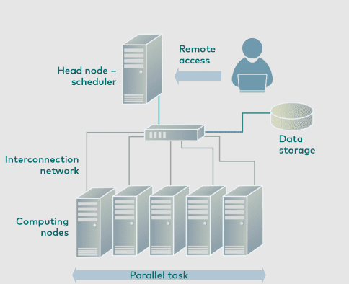
High Performance Computing (HPC)
Jethva, H. What is HPC? High Performance Computing and How it Works. Cloud Infrastructure Services. https://cloudinfrastructureservices.co.uk/what-is-hpc-high-performance-computing-and-how-it-works/ (accessed 2023-02-07).

Slide 24
Nodes
There are two types of nodes used to construct the connection between the servers. They are:
Head node: these are the nodes where users login in to interact with the HPC applications.
Compute nodes: these are the nodes where the real computing operation takes place.
There are three types of nodes used in the cluster, they are:
Entry nodes: these are the nodes where the user needs to connect to use the cluster in the system.
Storage nodes: these are the nodes where we can permanently store the data.
Worker nodes: these are the nodes where software programs run in the cluster.
Jethva, H. What is HPC? High Performance Computing and How it Works. Cloud Infrastructure Services. https://cloudinfrastructureservices.co.uk/what-is-hpc-high-performance-computing-and-how-it-works/ (accessed 2023-02-07).

Slide 25
High Performance Computing (HPC)
Jethva, H. What is HPC? High Performance Computing and How it Works. Cloud Infrastructure Services. https://cloudinfrastructureservices.co.uk/what-is-hpc-high-performance-computing-and-how-it-works/ (accessed 2023-02-07).

Slide 26
Schedulers
Scheduling
A job scheduler is a computer application for controlling unattended background program execution of jobs. This is commonly called batch scheduling, as execution of non-interactive jobs is often called batch processing. Schedulers help:
Helps to transfer the input data sets to the HPC (preferably by login nodes).
Creates the own set of job submission scripts to perform data computation tasks.
Then submit the job submission scripts to the scheduling.
The scheduling component runs the application programs.
Helps to analyze the result from the computations.
Jethva, H. What is HPC? High Performance Computing and How it Works. Cloud Infrastructure Services. https://cloudinfrastructureservices.co.uk/what-is-hpc-high-performance-computing-and-how-it-works/ (accessed 2023-02-07).

Slide 27
Schedulers
Some common schedulers: Sun grid engine, PBS/Torque, Slurm
$ cat submit.sub
An example of a PBS submission script
#PBS -N exampleScript # name of job
#PBS -P [Account] # account to which job is charged
#PBS -l nodes=1:ppn=1 # resources allocated, 1 node 2 processors
#PBS -l pmem=2gb # memory per core
#PBS -l walltime=15:00 # job will run at most 15 min
#PBS -q ctest # job is submitted to ctest queue
#PBS -j oe # output and error is combined into the same file
#PBS -o gettingStarted.out # output file is named gettingStarted.out
# computation starts here
cd $PBS_O_WORKDIR # changes into directory where script was submitted from
echo "Started on `/bin/hostname`" # prints name of compute node job was started on
Jethva, H. What is HPC? High Performance Computing and How it Works. Cloud Infrastructure Services. https://cloudinfrastructureservices.co.uk/what-is-hpc-high-performance-computing-and-how-it-works/ (accessed 2023-02-07).

Slide 28
Top10 HPCs
Rank | System | Location | Cores | Rmax (PFlop/s) | Rpeak (PFlop/s)
1 | Frontier - HPE Cray EX235a, AMD Optimized 3rd Generation EPYC 64C 2GHz, AMD Instinct MI250X, Slingshot-11 | DOE/SC/Oak Ridge National Laboratory, United States | 8,730,112 | 1,102.00 | 1,685.65
2 | Supercomputer Fugaku - Supercomputer Fugaku, A64FX 48C 2.2GHz, Tofu interconnect D, | RIKEN Center for Computational Science, Japan | 7,630,848 | 442.01 | 537.21
3 | LUMI - HPE Cray EX235a, AMD Optimized 3rd Generation EPYC 64C 2GHz, AMD Instinct MI250X, Slingshot-11 | EuroHPC/CSC, Finland | 2,220,288 | 309.10 | 428.70
4 | Leonardo - BullSequana XH2000, Xeon Platinum 8358 32C 2.6GHz, NVIDIA A100 SXM4 64 GB, Quad-rail NVIDIA HDR100 Infiniband | EuroHPC/CINECA, Italy | 1,463,616 | 174.70 | 255.75
5 | Summit - IBM Power System AC922, IBM POWER9 22C 3.07GHz, NVIDIA Volta GV100, Dual-rail Mellanox EDR Infiniband | DOE/SC/Oak Ridge National Laboratory, United States | 2,414,592 | 148.60 | 200.79
6 | Sierra - IBM Power System AC922, IBM POWER9 22C 3.1GHz, NVIDIA Volta GV100, Dual-rail Mellanox EDR Infiniband | DOE/NNSA/LLNL, United States | 1,572,480 | 94.64 | 125.71
7 | Sunway TaihuLight - Sunway MPP, Sunway SW26010 260C 1.45GHz, Sunway | National Supercomputing Center in Wuxi, China | 10,649,600 | 93.01 | 125.44
8 | Perlmutter - HPE Cray EX235n, AMD EPYC 7763 64C 2.45GHz, NVIDIA A100 SXM4 40 GB, Slingshot-10 | DOE/SC/LBNL/NERSC, United States | 761,856 | 70.87 | 93.75
9 | Selene - NVIDIA DGX A100, AMD EPYC 7742 64C 2.25GHz, NVIDIA A100, Mellanox HDR Infiniband | NVIDIA Corporation, United States | 555,520 | 63.46 | 79.22
10 | Tianhe-2A - TH-IVB-FEP Cluster, Intel Xeon E5-2692v2 12C 2.2GHz, TH Express-2, Matrix-2000 | National Super Computer Center in Guangzhou, China | 4,981,760 | 61.44 | 100.68

Slide 29
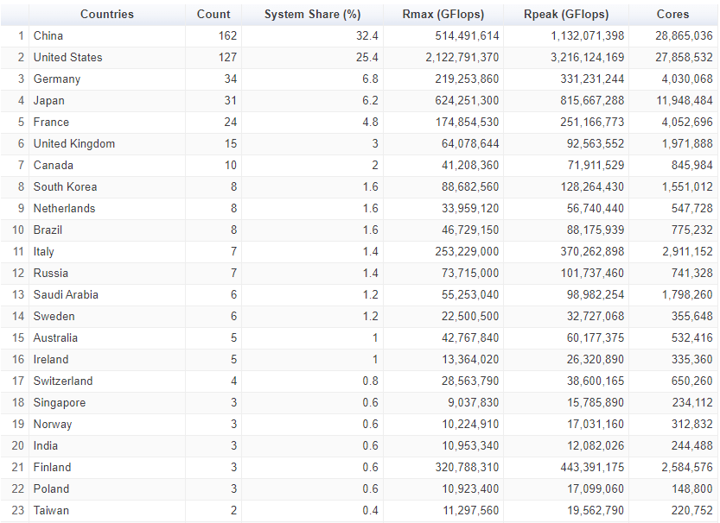
System share

Slide 30

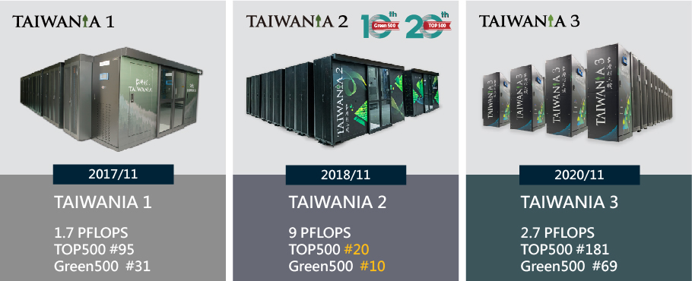

HPC in Taiwan
國研院國網中心自1991年成立以來，一直努力於打造國際級高速計算中心的實力與形象。2003年正式轉制為財團法人，隸屬於國家實驗研究院，簡稱為「國研院國網中心」，肩負起高效能計算、儲存、網路、平台整合的前瞻技術先導角色。
* 高效能計算，提升研發效率：規劃建置全球先進之高速計算環境，提供國內專家學者優質的高速計算服務、提升研發效率
* 高頻寬網路，整合分散資源：建置台灣高品質學術研究網路連結計算、儲存資源，並發展先進網路技術接軌歐亞美洲；更整合國內學術網路TWAREN與TANet，促成台灣與國際學術研究、教育能更緊密互動。
* 高備援儲存，確保資料安全：國家級三點儲存備援，充分降低資料傳輸的距離與延遲時間，確保重要研發成果及珍貴資料之安全與災難復原時效。

Slide 31
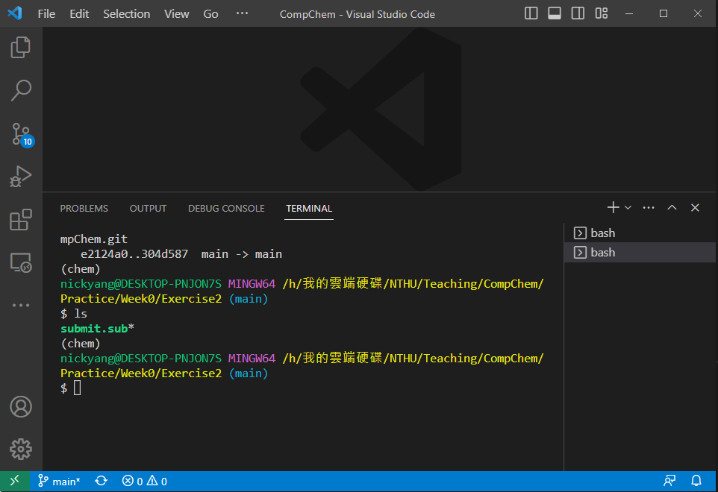
Interactive
Now let’s login to the cluster
Start vscode on your desktop
Login to the server by ssh ${USER}@140.110.148.11

Slide 32
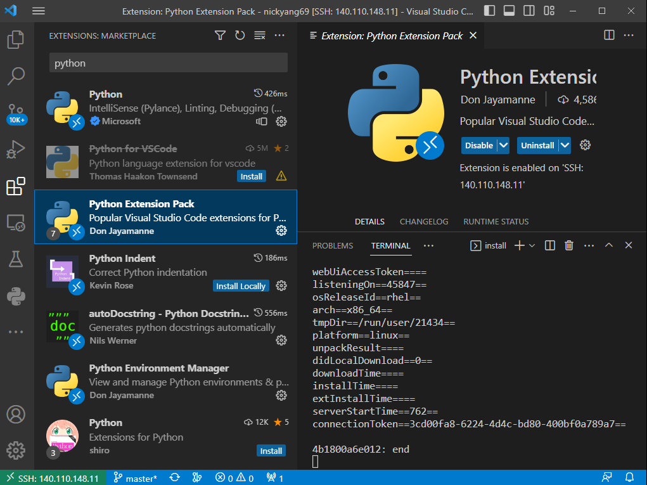
Interactive
After you are logged in, install extensions: Remote Explorere, Jupyter, Python Extension Pack

Slide 33
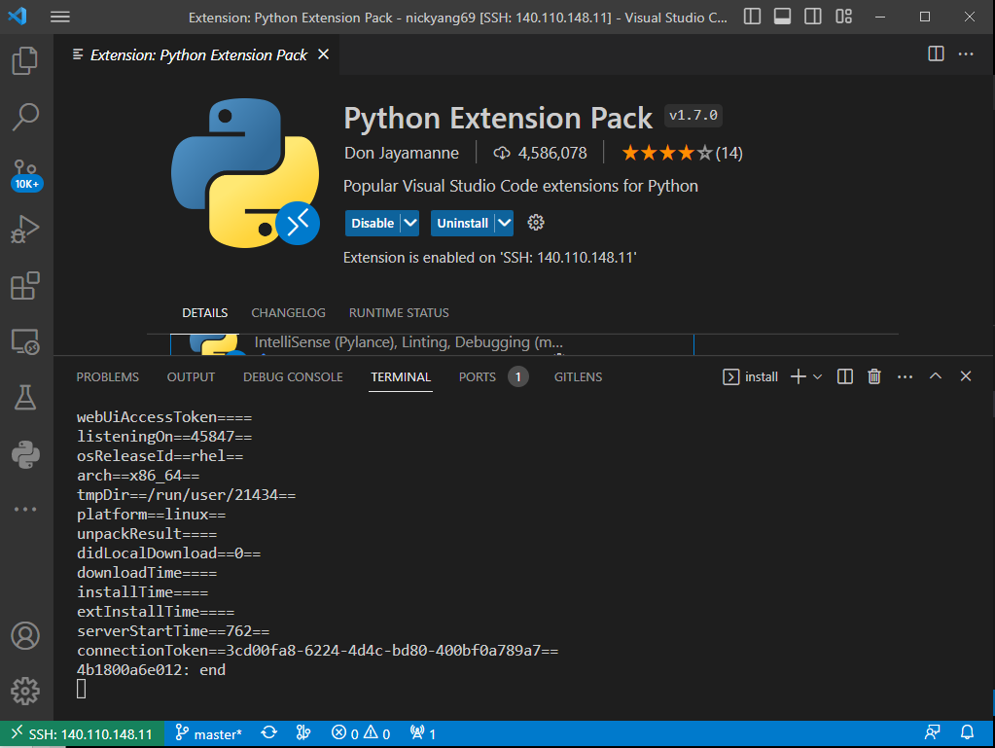
Interactive
Start a terminal

Slide 34
Interactive
In the terminal type
pwd
git clone https://github.com/tyangnthu/CompChem.git
cd CompChem/Practice/Week0/Exercise2
qsub submit.sub
watch -n 10 qstat -u $USER

Slide 35
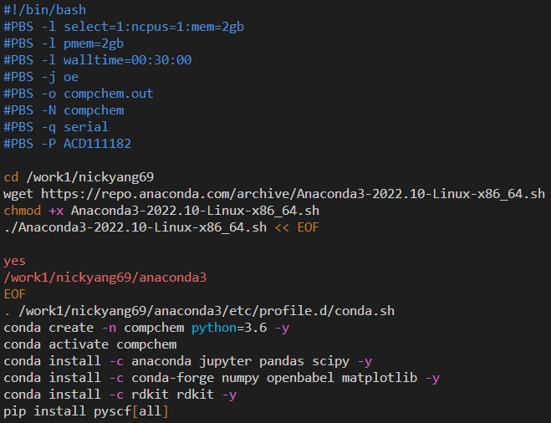
Interactive
If the queue seems ok after 6 refreshes (60 seconds) then let’s take a look at the submit.sub by running vi submit.sub

Slide 36
Molecular visualizers
Molecular visualizers: Graphic user interfaces that allow you to visualize molecules by their coordinates
Avogadro
Jmol
Mercury
PyMOL
UCSF Chimera
Vesta
VMD

Slide 37
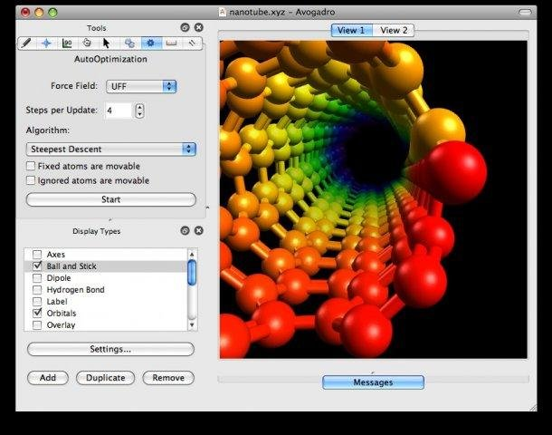

Avogadro
Avogadro is a molecular editor and visualizer with limited support for force field optimization. It is written as a GUI for the backend openbabel
Cross platform
Multiple language support

Slide 38
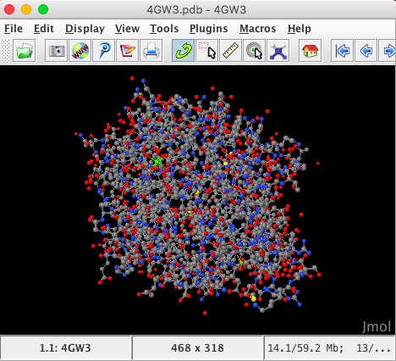

Jmol
Jmol is Molecular editor and visualizer written in Java (hence “J”mol).
It is callable by JavaScript making it automatable.
Cross platform

Slide 39

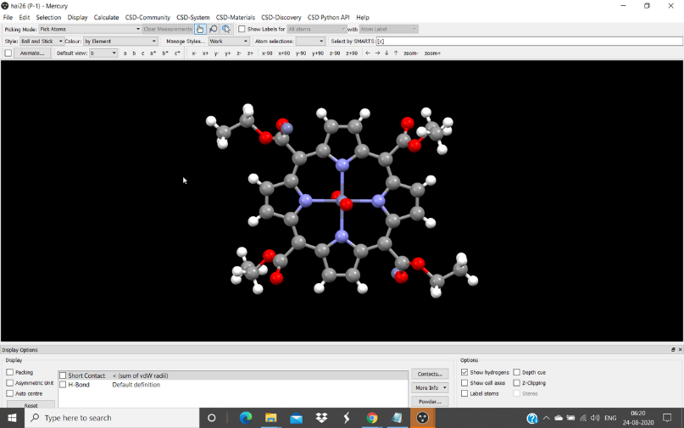

Mercury
Mercury is a molecular visualizer developed by the Cambridge Crystallographic Data Centre (CCDC)
It can be downloaded as a stand-alone software or as a part of the licensed CCDC software suite
It is specially designed to handle crystal structures
It has limited molecular building functionality

Slide 40

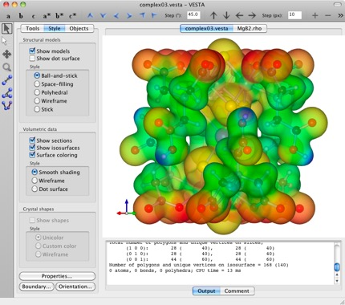
Vesta
Visualisation for Electronic Structural Analysis (Vesta) is a 3D visualization software
Strong support for extended crystal system

Slide 41
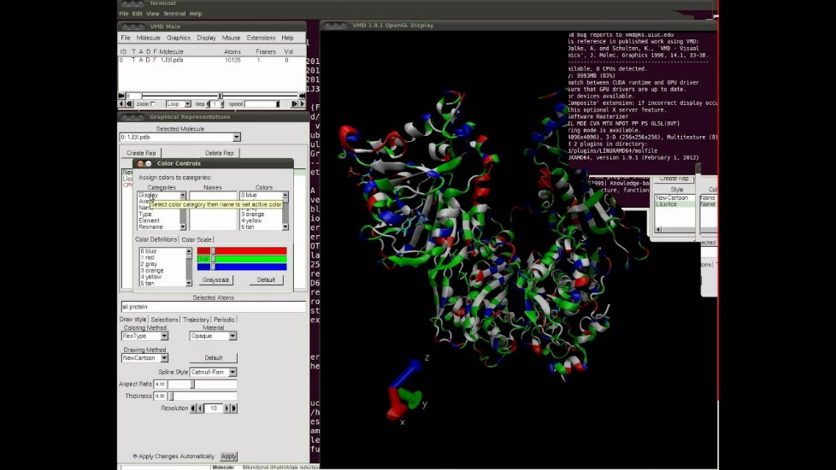

VMD
Visual Molecular Dynamics (VMD) is a molecular modeling and visualization software
Mainly for viewing and analyzing the results from molecular dynamics simulations
VMD has been developed by the group of Klaus Shulten at University of Illinois at Urbana-Champagin

Slide 42
Interactive
Back to your desktop
cd ~/Downloads/CompChem/Practice/Week0/Exercise3
Play around with the files in the folder using Avogadro
There are 4 types of files of molecular structures: cif, pdb, xyz, and mol2
cif is the crystallographic information file
pdb is the protein databank file
xyz is the cartesian coordinate file
mol2 is the tripos molecule structure file

Slide 43
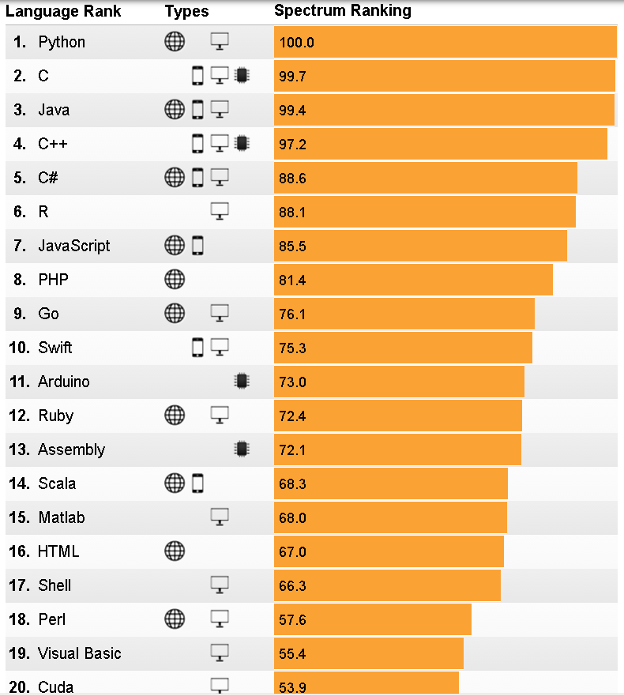

Python
Python is a high-level, general-purpose, object-oriented programming language. Its design philosophy emphasizes code readability with the use of significant indentation.
Guido van Rossum began working on Python in the late 1980s as a successor to the ABC programming language and first released it in 1991 as Python 0.9.0.
Python is the most widely used programming partly owing to its comprehensive standard library

Slide 44
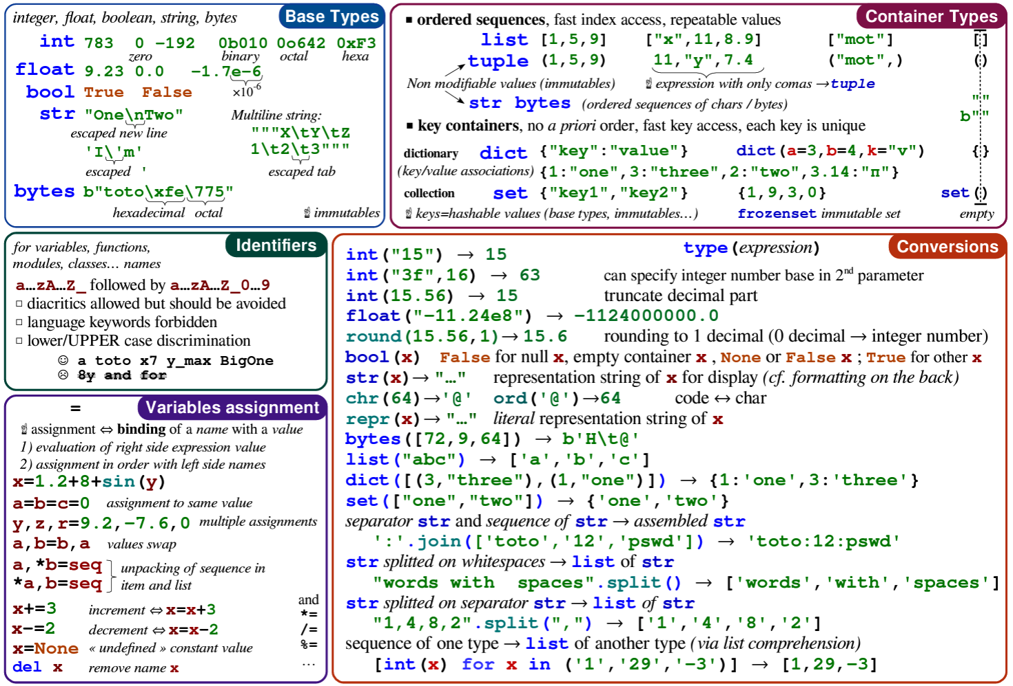
Python cheat sheet

Slide 45
Interactive
Back to the terminal, let’s repeat what we have just done using bash with Python
Start the python kernel by typing python
Check the current working directory by
import os
os.getcwd() (get current working dir)
os.chdir(‘../Exercise1/AB’) (cd into ‘../Exercise1/AB’)
os.listdir() (list all the files in the dir)
len(ls.listdir()) (return the number of files in the dir)
Open the file to be modified
f = ‘ABABUE.xyz’
content = open(f,’r’).read()
Check the content by print(content)

Slide 46
Interactive
Let’s repeat what we have just done using bash with Python
Start the python kernel by typing python
Check the current working directory by
import os
os.getcwd()
Open the file to be modified
f = ‘../Exercise1/AB/ABABUE.xyz’
content = open(f,’r’).read()
Check the content by print(content)

Slide 47
Interactive
lines = content.splitlines() (turn content (string) into a line)
Append the new element, ’H 0.00 0.00 0.00’ into lines by lines += [‘H 0.00 0.00 0.00’]
idxes = [i for i, line in enumerate(lines) if line.startswith('C ‘)] (this is a list generator that loops through each line in lines and return the index of the line if the line starts with ‘C ‘; enumerate returns tuples, a data type similar to list, of the index and the value of the element.)
del lines[idxes[1]] (delete the n^{th} element of lines where n is the second element of lnums. Note that Python starts counting at 0.)

Slide 48
Interactive
lines = [line.replace('C ','Cl ') if line.startswith('C ') else line for line in lines]
idxes = [i for i, line in enumerate(lines) if line.startswith(‘N ‘)]
lines[idxes[0]] += ’ M = 15’ (append to the n^{th} element by the string ‘ M = 15’ where n = lnums[0])
idxes = [i for i, line in enumerate(lines) if line.startswith(‘Ir ‘)]
del lines[idxes[0]: idxes[0]+8] (delete the n^{th} elements in lines for n = idxes[0], idxes[0]+1,…, idxes[0]+7. Notce that idxes[0]+8 is not deleted—slicing a list, i.e. list[a:b], returns a list with a^{th}, a+1th,…,b-1th elements of the original list.)

Slide 49
Interactive
lines = [line.replace('C ','Cl ') if line.startswith('C ') else line for line in lines]
idxes = [i for i, line in enumerate(lines) if line.startswith(‘N ‘)]
lines[idxes[0]] += ’ M = 15’ (append to the n^{th} element by the string ‘ M = 15’ where n = lnums[0])
idxes = [i for i, line in enumerate(lines) if line.startswith(‘Ir ‘)]
del lines[idxes[0]: idxes[0]+8] (delete the n^{th} elements in lines for n = idxes[0], idxes[0]+1,…, idxes[0]+7. Notce that idxes[0]+8 is not deleted—slicing a list, i.e. list[a:b], returns a list with a^{th}, a+1th,…,b-1th elements of the original list.)

Slide 50
Interactive
lnum = len(lines)-2 (len() returns the length of a list. -2 because the first two lines don’t contain coordinate information)
lines[0] = lnum
Write the new file out
open(f,’w’) as fout:
fout.write(‘\n’.join(lines))
exit()
Note we used ‘w’ mode instead of ‘r’ mode like we did before; watch out for the indent, created by tab. Python is indent sensitive; ’\n’.join() return a string of all the elements in the list lines joined by the specified delimiter, ‘\n’.

Slide 51
Interactive
It seems that it is not more convenient to use Python than Bash. Now, let’s try another one that will be almost impossible to do with Bash.
cd ../Exercise4
unzip organics.zip
ls
Now, we are faced with more than 100 files that it will take minutes to hours to visualize them and figure out which ones we want. But we can actually do this efficiently.
realpath xyz_to_drawing.ipynb
Open xyz_to_drawing.ipynb by holding ctrl then click on the system output

Slide 52
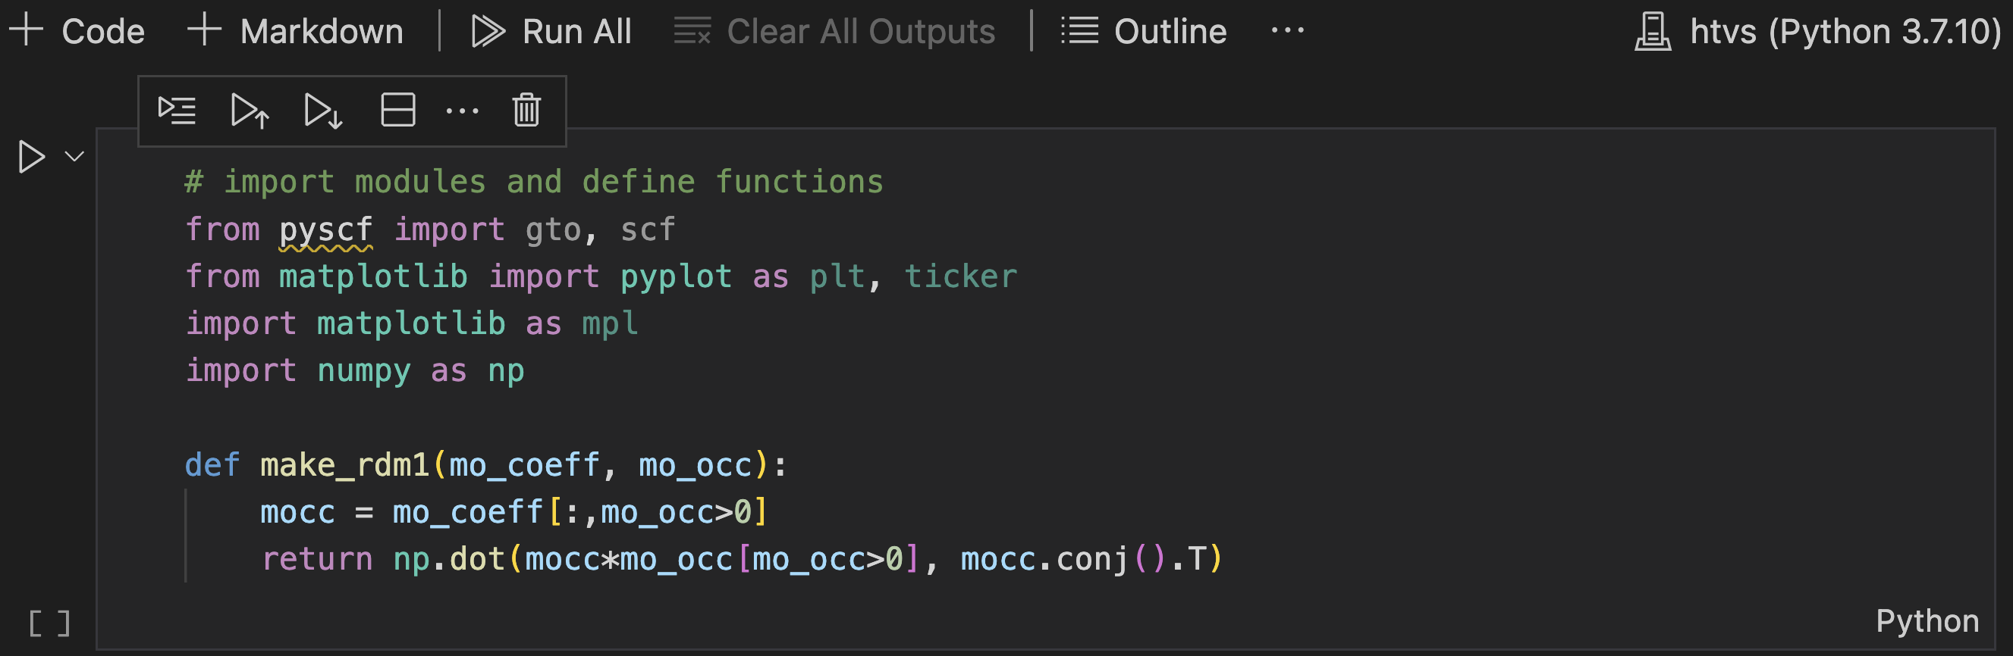
Interactive
In the jupyter notebook, check the env (compchem)
Click ”Run All”

